Slide 1
Kinetic simulation of disease transmission
Max Curie

Slide 2
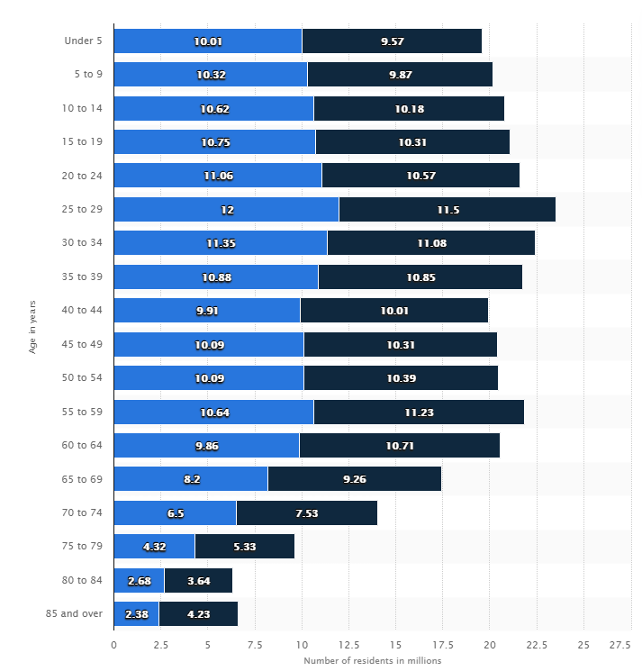
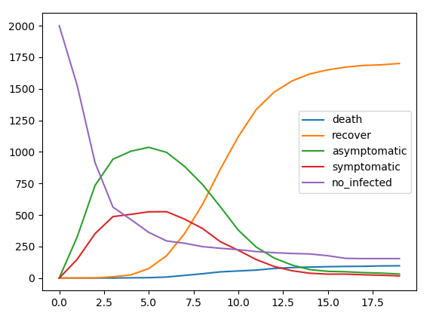
Kinetic simulation of disease transmission(Python)
Max Curie
Analyze data set from CDC for age distribution of the disease
Realistic density distribution
Age distribution(death, asymptomatic, symptomatic)
Modeling commute
Analyze data for indirect impact of COVID
Traveling, moving(mobility)
Mental health
Physical health not related to COVID
Propose strategy for future plague prevention
And more!
Other idea
GPT-3
Blockchain voting system
WebMD diagnostic UI
Data acquire and verification
Context of article and video suggestion bot

Slide 3
Suggestions to other groups
GPT-3 from https://openai.com/blog/openai-api/
https://youtu.be/_x9AwxfjxvE
Blockchain voting system
UI for symptom descriptions and guidance for accurate WebMD diagnostic
Data acquire and verification using basic statistic theory (Benford's law) https://en.wikipedia.org/wiki/Benford%27s_law
Context of article and video suggestion bot.
(Me: “I cannot love physics enough” ===>
Media: “Breaking news, Max cannot love physics”)

Slide 4
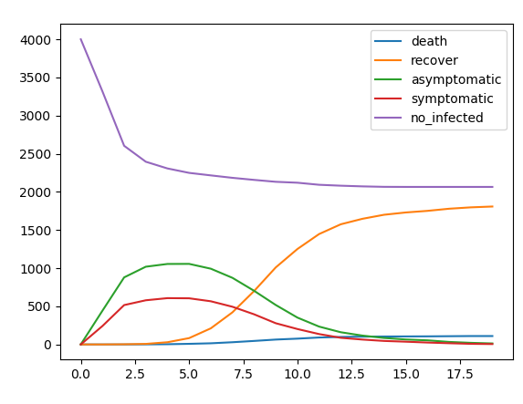

Slide 5
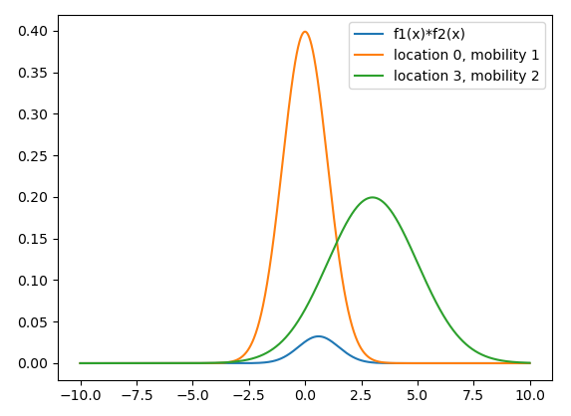
Cross section calc

Slide 6
Work options during the Hackathon
Analyze data set from CDC for age distribution of the disease
Realistic density distribution
Age distribution(death, asymptomatic, symptomatic)
Modeling commute
Analyze data for indirect impact of COVID
Traveling, moving(mobility)
Mental health
Physical health not related to COVID
Propose strategy for future plague prevention
And more!

